Slide 1

Medical Image Classification Using Deep Learning
B.Tech Project
BY:
Shivdutt Tiwari (20223251) Shreyansh Tiwari (20223256) Shubham Kumar (20223259)
Sreyia Gupta (20223547)
Supervisor: Dr. Rajitha B.

Slide 2
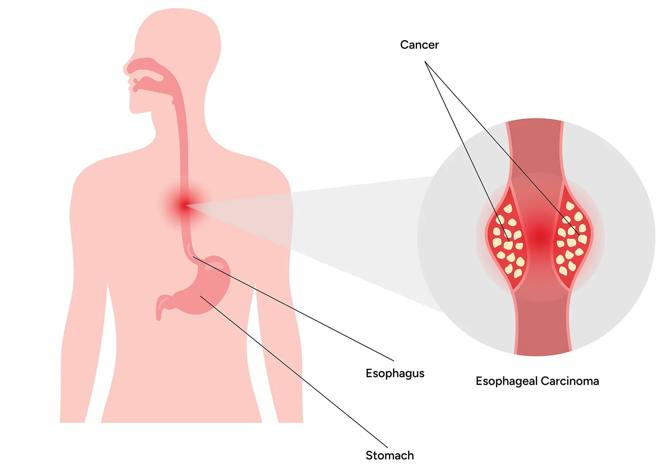

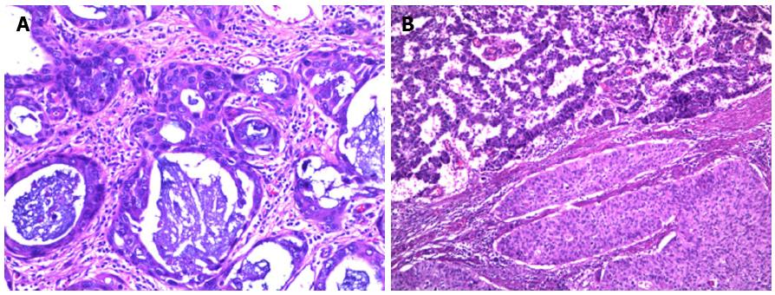
The Challenge of Esophageal Carcinoma
Esophageal carcinoma is a very serious cancer that is often found late, which makes it’s treatment difficult.
Histopathology is the best for diagnosis, but manual analysis is:
•
Time-consuming and labor-intensive.
•
Results can vary from one observer to another.
•
The tissue patterns are very complex
We need a faster, more reliable computer-aided system to help doctors.

Slide 3
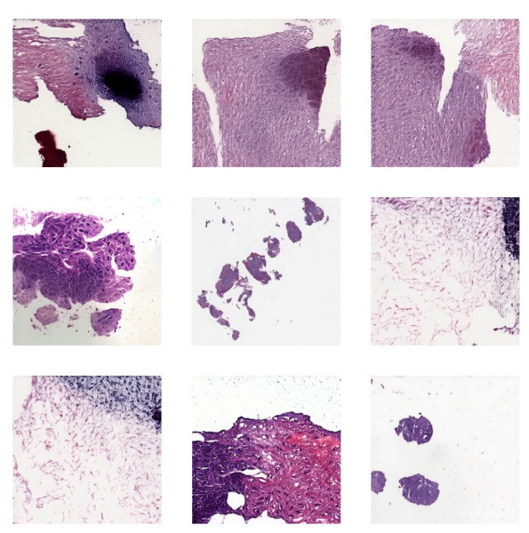
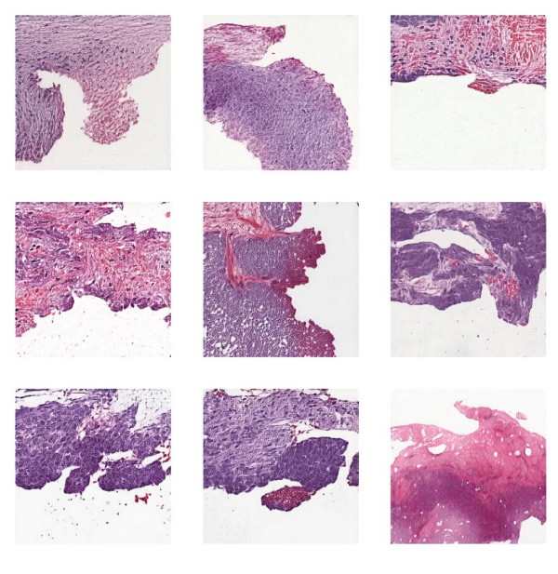
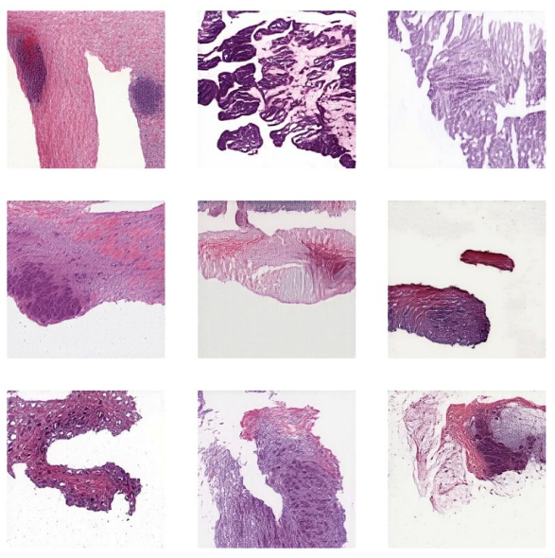


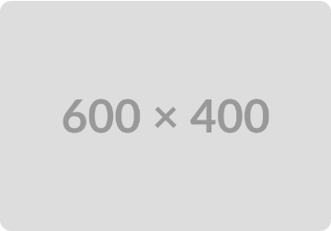
Types of Esophageal Carcinoma
Esophageal Adenocarcinoma (EAC)
Esophageal Squamous Cell Carcinoma (ESCC)
Esophagogastric Cancer (EGC)
develops near the lower part of the esophagus, where it joins the stomach.
usually develops in the upper and middle parts of the esophagus.
"hybrid" type found right at the junction, and it has features of both other types.

Slide 4
Project Objectives
Develop ECC-Net: To create an efficient and accurate hybrid deep learning model, ECC-Net, adapted from RCG-Net.
Combine Strengths: To integrate the local feature extraction power of CNNs with the global context modeling of Transformers.
Enhance Accuracy: To improve the automated classification of three Esophageal Carcinoma subtypes (EAC, ESCC, EGC).
Optimize Efficiency: To achieve high diagnostic performance without the massive computational cost of a pure Transformer model.

Slide 5
Building on Existing Research
CNNs: Proven effective for local feature extraction in histopathology (Xu et al., 2017). They are the baseline for many image tasks.
Vision Transformers (ViTs): A newer architecture that uses attention to capture long-range dependencies and global patterns (Dosovitskiy et al., 2021).
Hybrid Models: Show significant promise by combining CNNs (for feature extraction) with ViTs (for context) to get the best of both worlds (Pal et al., 2025).
Data Challenges: Medical datasets are often small and imbalanced. GANs (like HistoGAN) are used to augment data and improve model robustness.

Slide 6
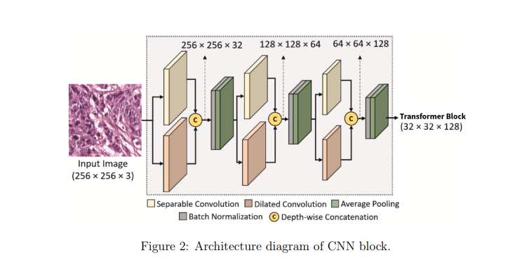
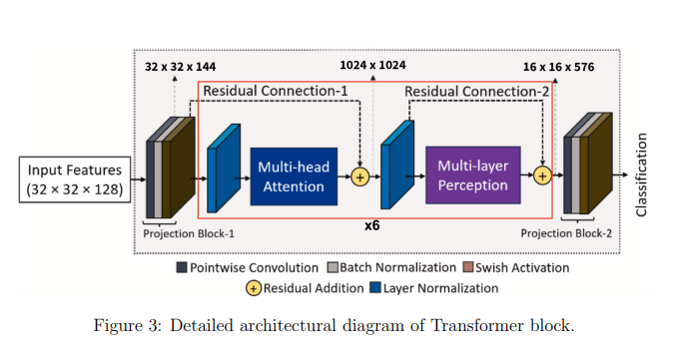
ECC-Net Architecture
CNN Block (Local Features)
Uses parallel Separable and Dilated Convolutions. This captures fine-grained local patterns and textures at multiple scales, identifying cellular-level details.
Transformer Block (Global Context)
Applies Multi-Head Attention to the features from the CNN. This models long-range dependencies and global relationships across the entire patch.
Result: A comprehensive feature map that understands both the "cells" and the "tissue structure."

Slide 7
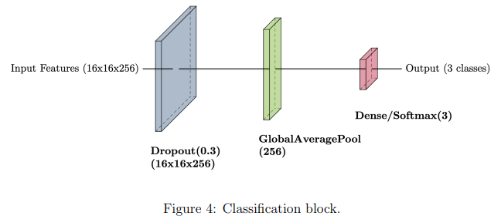
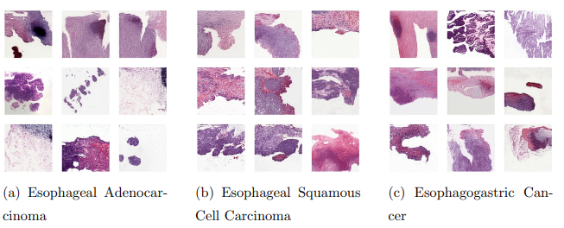
ECC-Net Architecture
Classification block
Fused feature map from CNN and transformer blocks into class probabilities.
It uses :
Dropout for regularization
Global average pooling to summarize spatial information
Dense layer with softmax for prediction
This classification module effectively combines local texture features and global context to predict the esophageal carcinoma class.

Slide 8
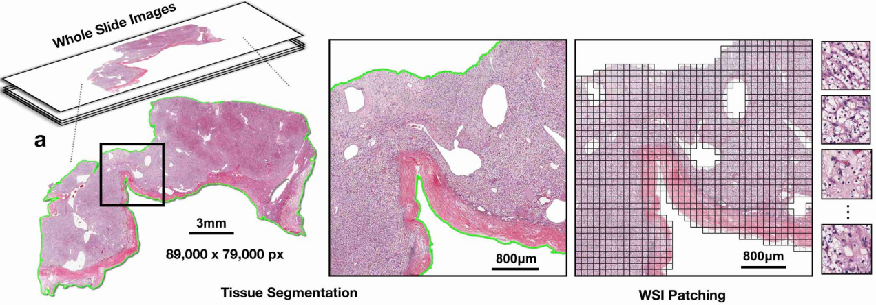
Data Preprocessing
Start (Raw Data): We start with huge 2-3 GB files called Whole-Slide Images (.SVS).
Step 1 (QuPath): We use QuPath to find and crop only the important tissue areas, ignoring the empty white background. And converting the .SVS (Slide and Viewable Storage) file to .JPG (Joint Photographic Experts Group)
Step 2 (PixCell-256): We use PixCell-256 to break the cropped tissue into thousands of small 256x256 "patches.“
Step 3 (Augmentation): We add random "noise" to the patches. This teaches the model to ignore unimportant errors and reduces overfitting.

Slide 9




Proposed Solution: ECC-Net Workflow
1. Patch Extraction
2. Data Augmentation
3. Hybrid Feature Extraction
Whole-slide images (.SVS) are converted to .jpg and cropped to obtain relevant tissue regions. These are then divided into 256x256 pixel patches using PixCell-256.
Data augmentation applied by adding Gaussian noise and Salt-and pepper noise at random to increase dataset variability and reduce overfitting
Our model, ECC-Net, (adapted from RCG-Net) uses a CNN block for local features and a Transformer block for global context.

Slide 10

Proposed Solution: ECC-Net Workflow
4. Subtype Classification
5.Testing and Validation
The rich, combined features are fed into a classification head to accurately identify the esophageal carcinoma subtype.
Testing the model on testing dataset that we obtained when we did the test train split

Slide 11
Experimental Setup
Environment: Google Colab (NVIDIA T4 GPU)
Framework: TensorFlow 2.x & Torch 2.x
Optimizer: AdamW (Learning Rate: 1x10⁻⁴)
Loss Function: Sparse Categorical Cross-Entropy
Key Techniques: Mixed-Precision (float16) for efficiency, Class Weights to handle imbalance.
Callbacks: Early Stopping (Patience 9), ReduceLROnPlateau, Model Checkpointing.

Slide 12
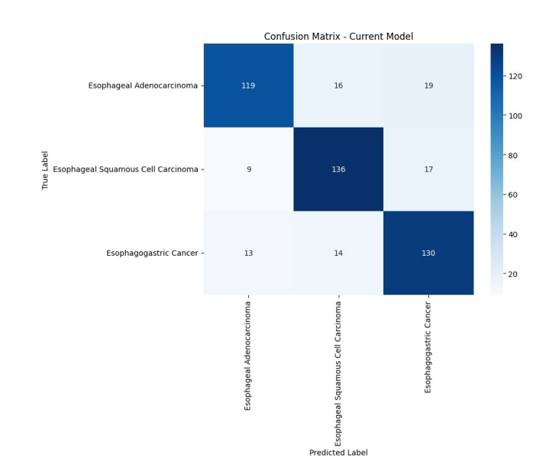
Results: Classification Report
The model performs very well in identifying Esophageal Squamous Cell Carcinoma, with high accuracy across all measures.
For Esophageal Adenocarcinoma, the model is mostly accurate but misses a few cases.
Esophagogastric Cancer is the hardest to classify, as the model makes more mistakes here, showing that this class needs further improvement.
Class | Precision | Recall | F1-score
Esophageal Adenocarcinoma | 0.84 | 0.77 | 0.81
Esophageal Squamous Cell Carcinoma | 0.82 | 0.84 | 0.83
Esophagogastric Cancer | 0.78 | 0.83 | 0.80
Average | 0.82 | 0.81 | 0.81
Accuracy : 81%

Slide 13
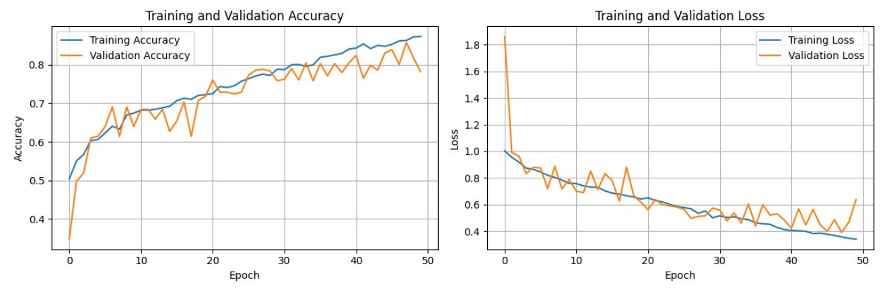
Results: Evaluation Metrics
Training accuracy steadily increases, surpassing 80% by the end of the epochs, with validation accuracy following a similar upward trend .
Training loss consistently decreases, while validation loss initially drops, fluctuates, and then stabilizes above the training loss.

Slide 14
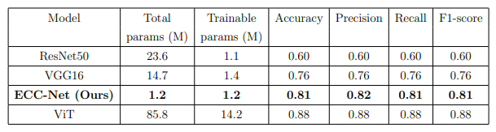
Results:
Model Comparison
Key takeaway: ViT has highest Accuracy but it is ~12x larger. ECC Net achieves comparable and strong performance at a fraction of the computational cost.

Slide 15


Conclusion & Limitations
Summary of Findings
Limitations
Our hybrid ECC-Net model effectively classifies Esophageal Carcinoma subtypes by balancing local and global feature extraction.
The primary limitation was the small and imbalanced dataset. While addressed with data augmentation and class weights, a larger dataset would improve generalization.
It achieves strong performance (81% F1-score) while remaining lightweight (1.2M params), making it a highly efficient and practical tool for AI-assisted diagnosis.
The transformer component, while effective, still adds computational complexity compared to a simple CNN.

Slide 16
THANK YOU
Any Questions?

